Slide 1
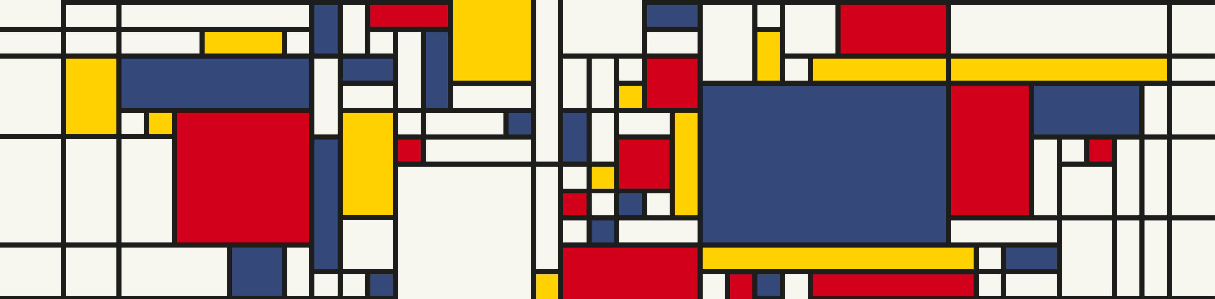
A Glimpse on Conformal prediction
Michel Lutz
Institut für
Medizinische Systembiologie

Slide 2
Agenda
What is CP?
Coverage guarantee
LAC, APS
Split, CV+, Jackknife+
2. Experiment
Data
Results
3. Where to start?
4. History of CP
5. Marginal vs. Conditional Coverage
Group-balanced CP
Class-balanced CP
6. Conformal Change Point Detection
CTM
PERMAD Dataset

Slide 3
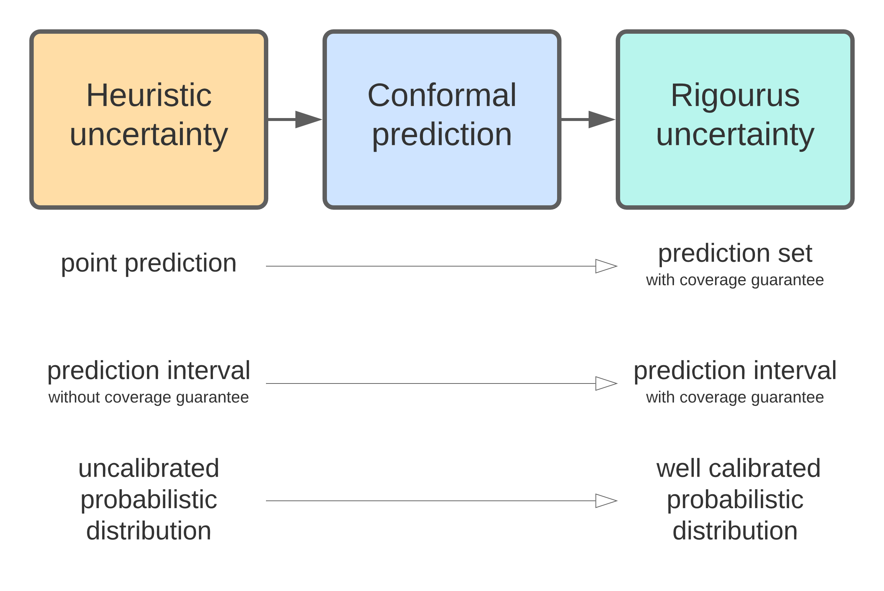
(Venn predictors)

Slide 4
Coverage guarantee
model agnostic
distribution free
finite sample size
minimal assumptions
(exchangeability)
Notes:
marginal coverage, since the probability is marginal (averaged) over the randomness in the calibration and test points

Slide 5
Exchangeability
Weaker then iid.
swap
After swapping the datasets cannot be distinguished

Slide 6
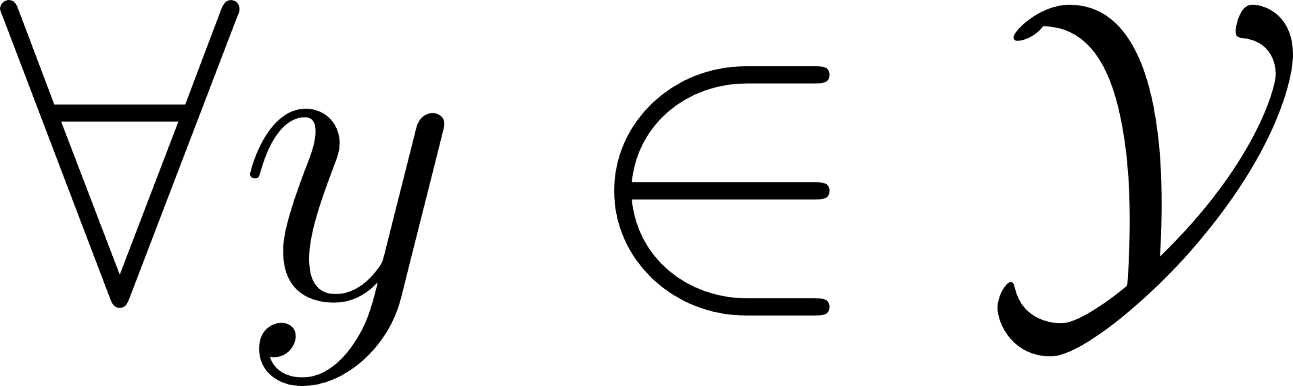
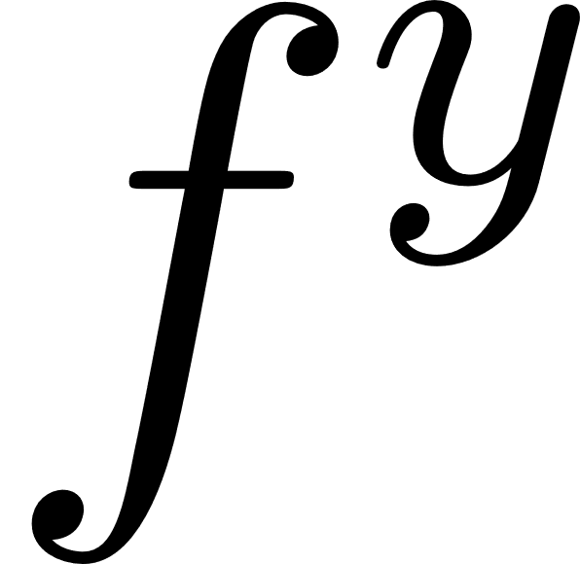
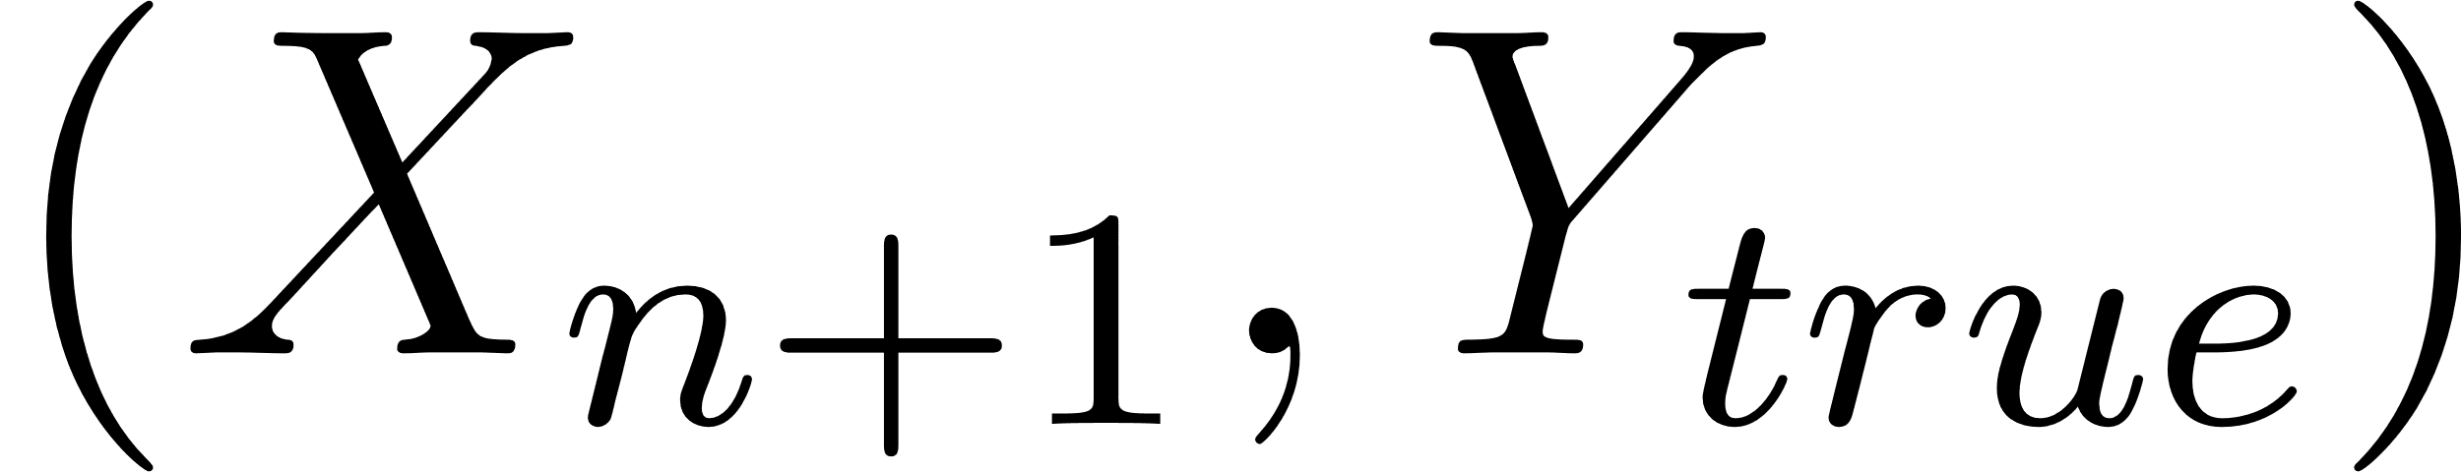
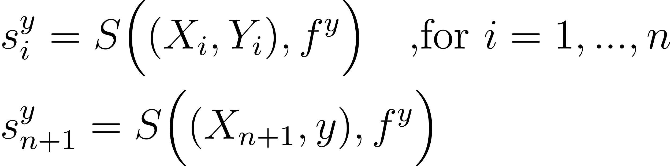
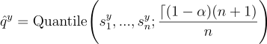
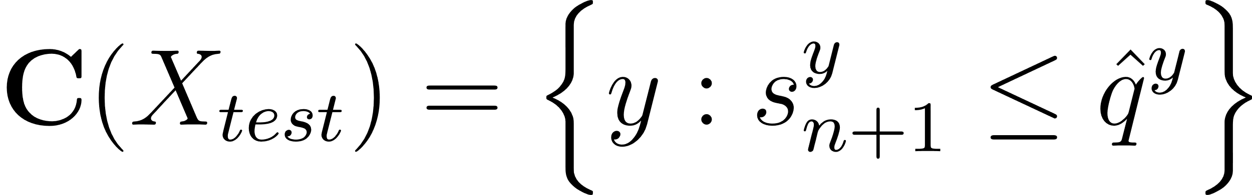
Full Conformal Prediction
train one model for each label in the label space
exchangeable to all other points
Conformity scores
1-alpha quantile
Prediction set

Slide 7
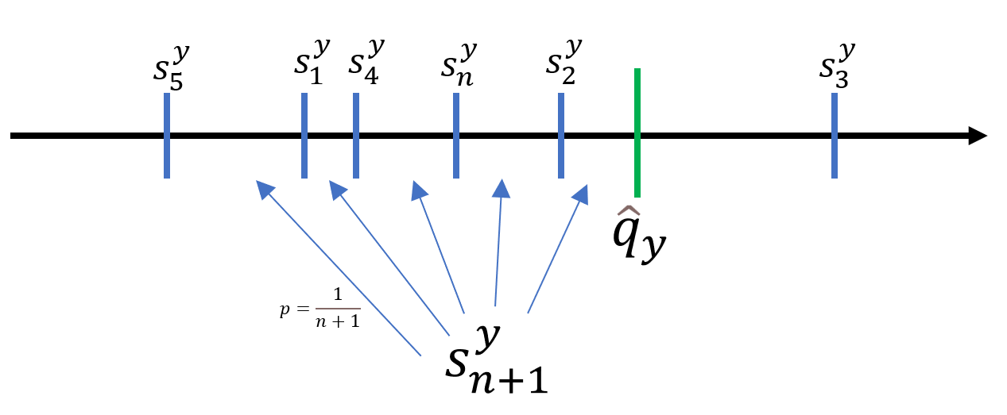


1-alpha quantile
$$1− α$$
$$α$$
Reason: exchangeability of the data

Slide 8
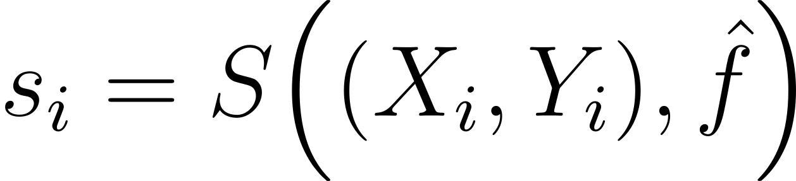
Conformity score
The higher, the more strange the data point is for the rest of the data
Can be an arbitrary function
Coverage guarantee holds for all conformity scores
BUT! : Informativeness (size of the prediction set) depends on S
S = Noise function -> Prediction set has size 1-alpha of the label space

Slide 9
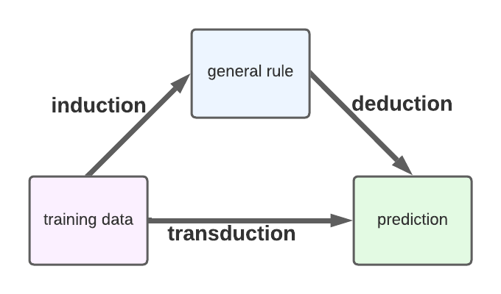
Split vs. Full Conformal prediction
Full CP
transductive
train one model for each possible label
start for each prediction from scratch
+ hight data efficiency
- high computational effort
Split CP
inductive
split data in training
and calibration set
only train model once
- low data efficiency
+ low computational effort
+ can be used for pretrained models

Slide 10
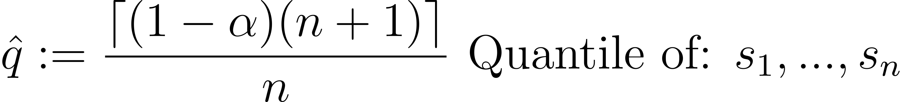
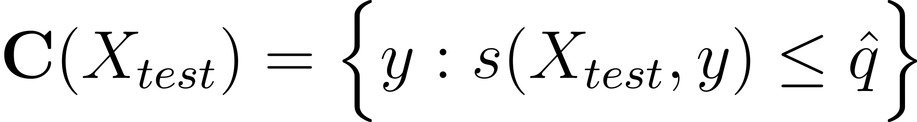
Split conformal prediction
Calibration set
Conformity score
1-alpha Quantile
Prediction set
[2] Angelopoulos, A. N., & Bates, S. (2021)

Slide 11
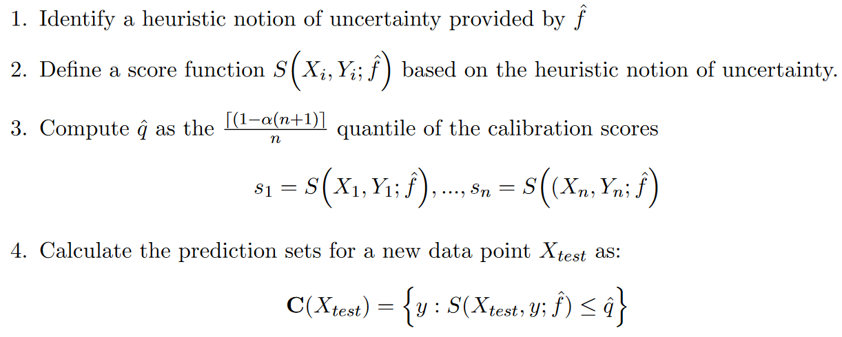
Conformal recipe (for split CP)

Slide 12
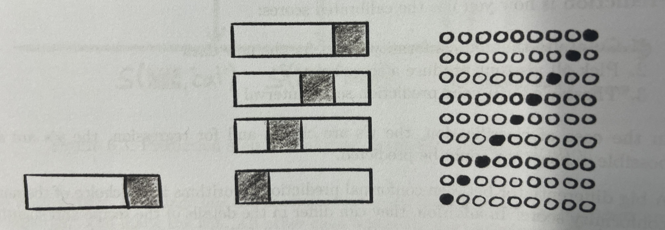
Split, CV+, Jackknife+
Split
CV+
Jackknife+

Slide 13
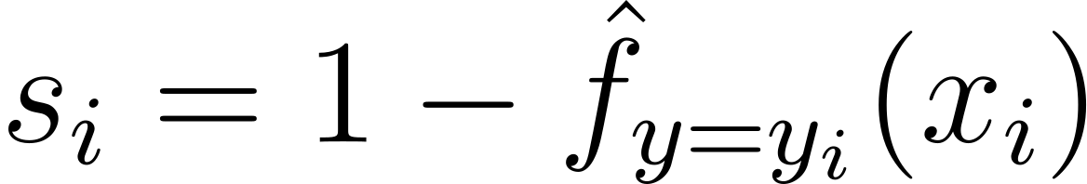
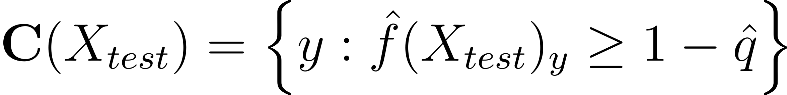
Least Ambiguous set-valued Classifier (lac)
uses only the probability of the true label
smallest prediction sets (on average)
lacks adaptivity
[4] Lei, J., & Wasserman, L. (2014)

Slide 14
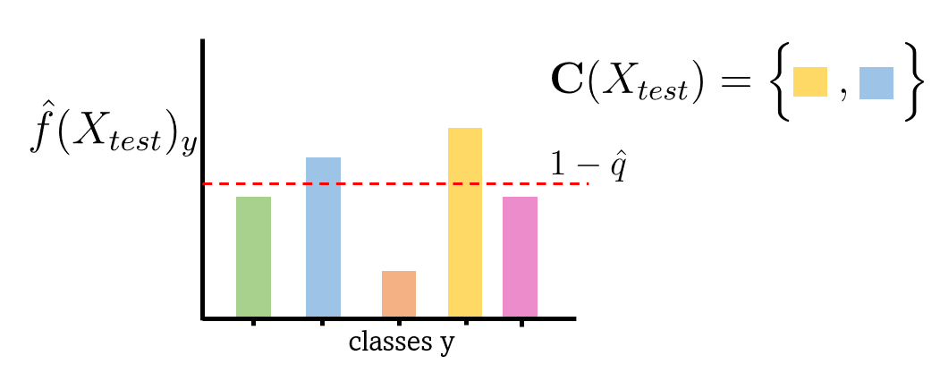
Least Ambiguous set-valued Classifier (lac)

Slide 15
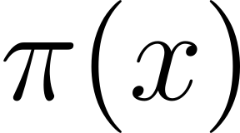
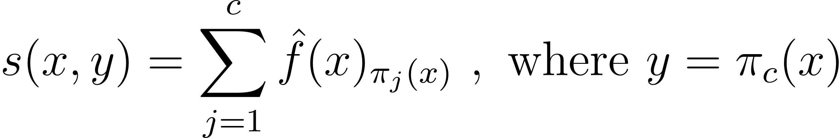
Adaptive prediction scores
Permutation that sorts classes from most to least likely
includes the difficulty of a prediction point
utilizes the scores of all classes, not just the true class
more adaptive
[5] Lei, J. (2014)

Slide 16
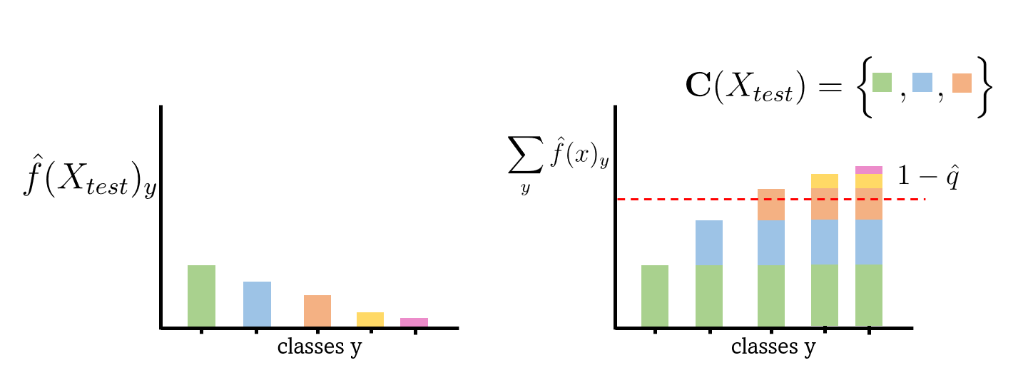
Adaptive prediction scores

Slide 17
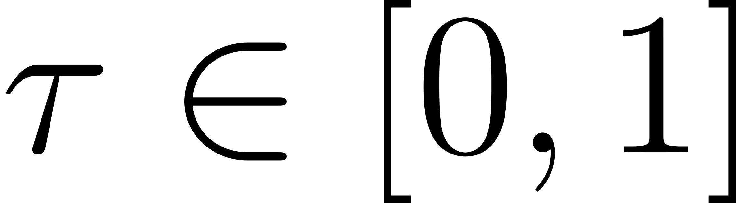
Adaptive classification with split-conformal calibration (aps)
generalized conditional quantile function for an arbitrary
works in principle like the other variant
includes theoretical guarantees and tie-breaking
[3] Romano, Y., Sesia, M., & Candes, E. (2020)

Slide 18
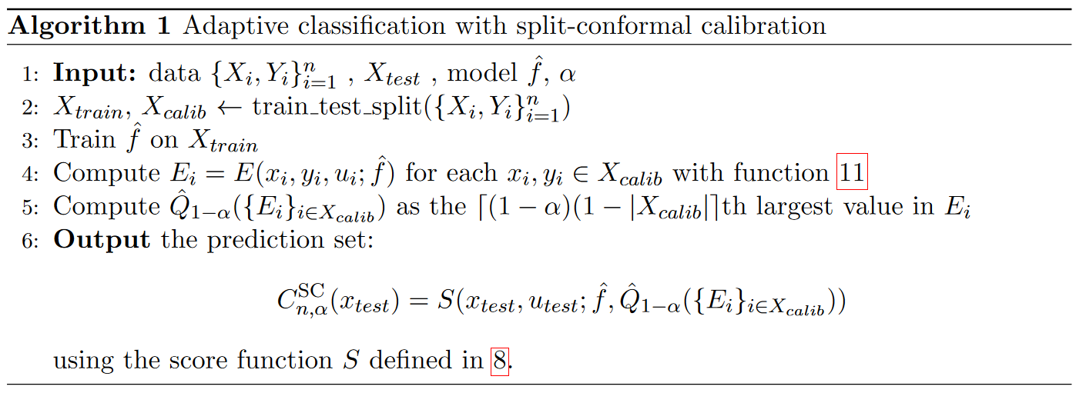
Adaptive classification with split conformal calibration
[3] Romano, Y., Sesia, M., & Candes, E. (2020)

Slide 19
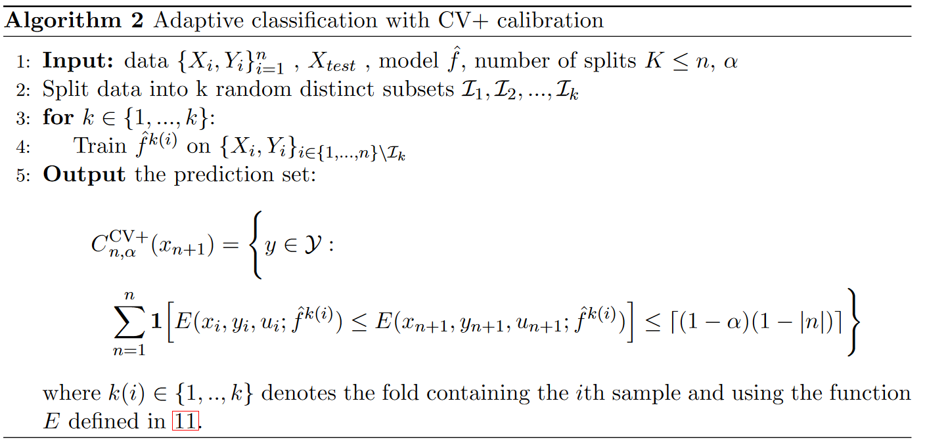
Adaptive classification with CV+
[3] Romano, Y., Sesia, M., & Candes, E. (2020)

Slide 20
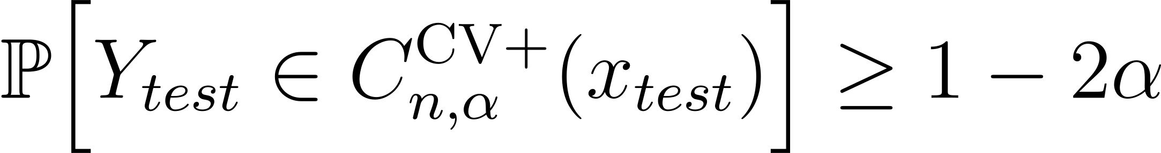
Coverage guarantee for CV+
CV+
Jackknife+
Special case of CV+ with k=n
[3] Romano, Y., Sesia, M., & Candes, E. (2020)

Slide 21
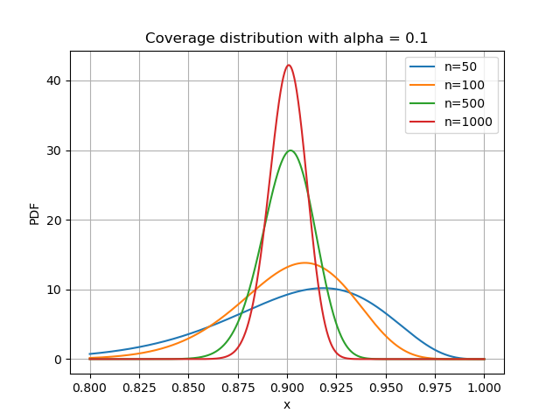
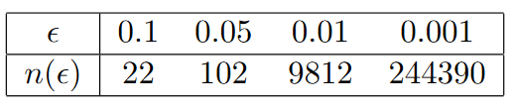
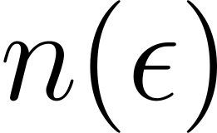
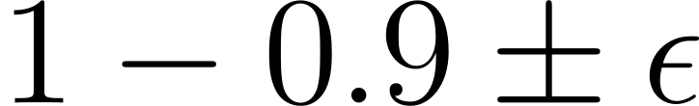
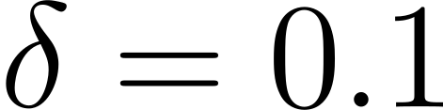
Influence of Calibration Set Size
Coverage guarantee holds for
coverage of 1 − α on average over the randomness in the calibration set
Required calibration set size
for coverage of
with probability
[1] Vovk, V. (2012)

Slide 22
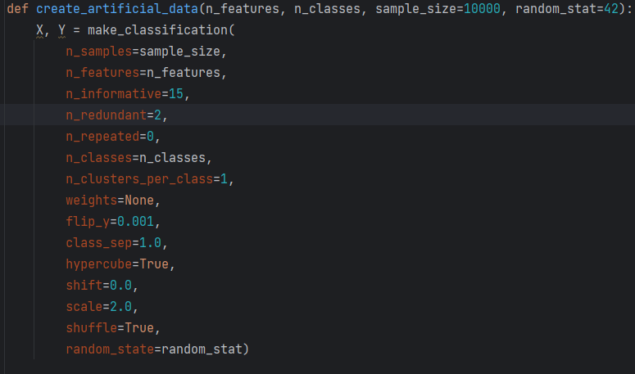
Artificial dataset
20 features
5 classes
10.000 datapoints
5000 for training/calibration
(rest) for testing
Dry Beans dataset
13,611 dry beans
7 variants (classes)
8 features (length, roundness…)
[6] Koklu, M., & Ozkan, I. A. (2020)

Slide 23
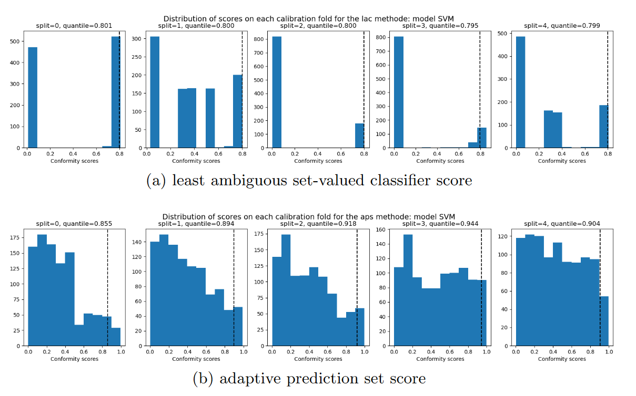
Influence of different splits on the conformal scores

Slide 24
Influence of small datasets on different conformal methods
Split :
20% of the training data as calibration set
CV+ :
k=5 splits
mean aggregation
cross-validation aggregation
Jackknife+
like CV+ with k=n

Slide 25
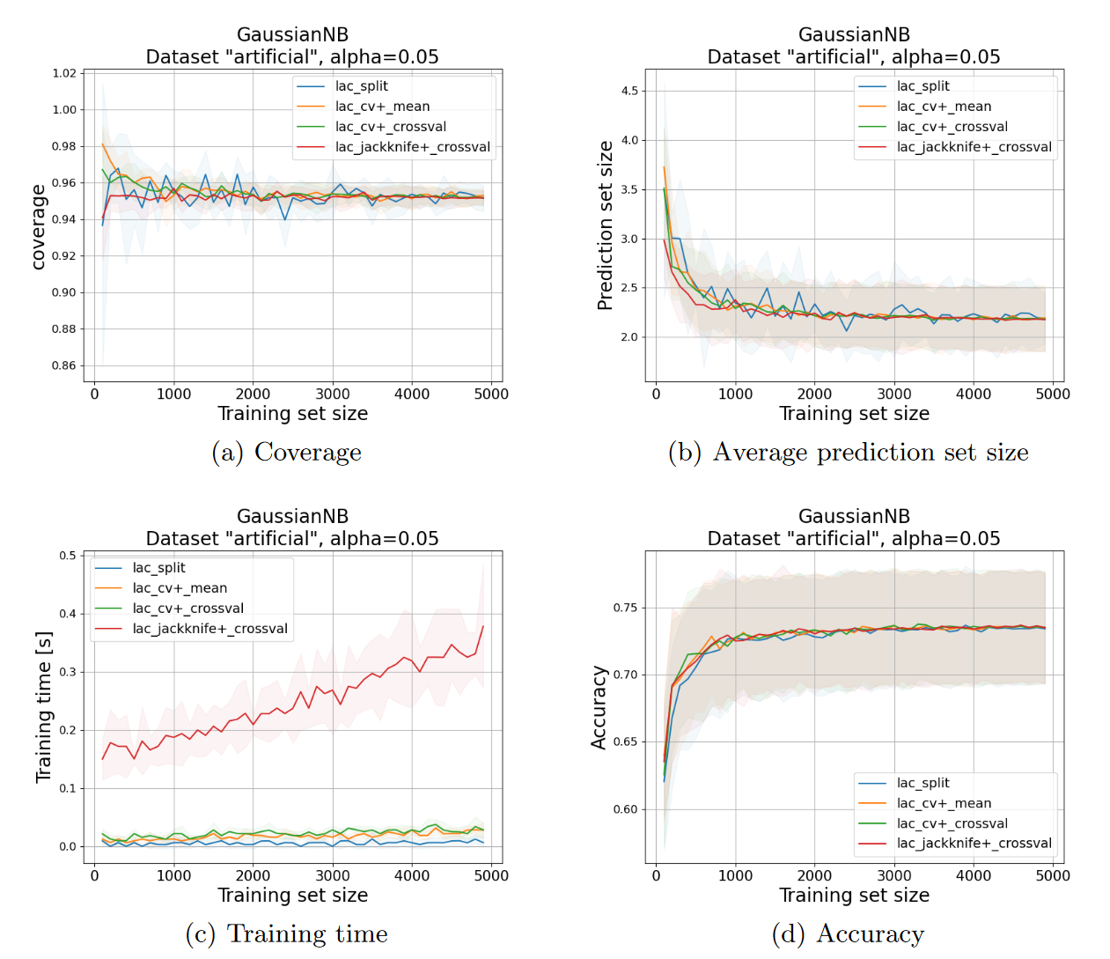
Influence of small datasets on different conformal methods

Slide 26
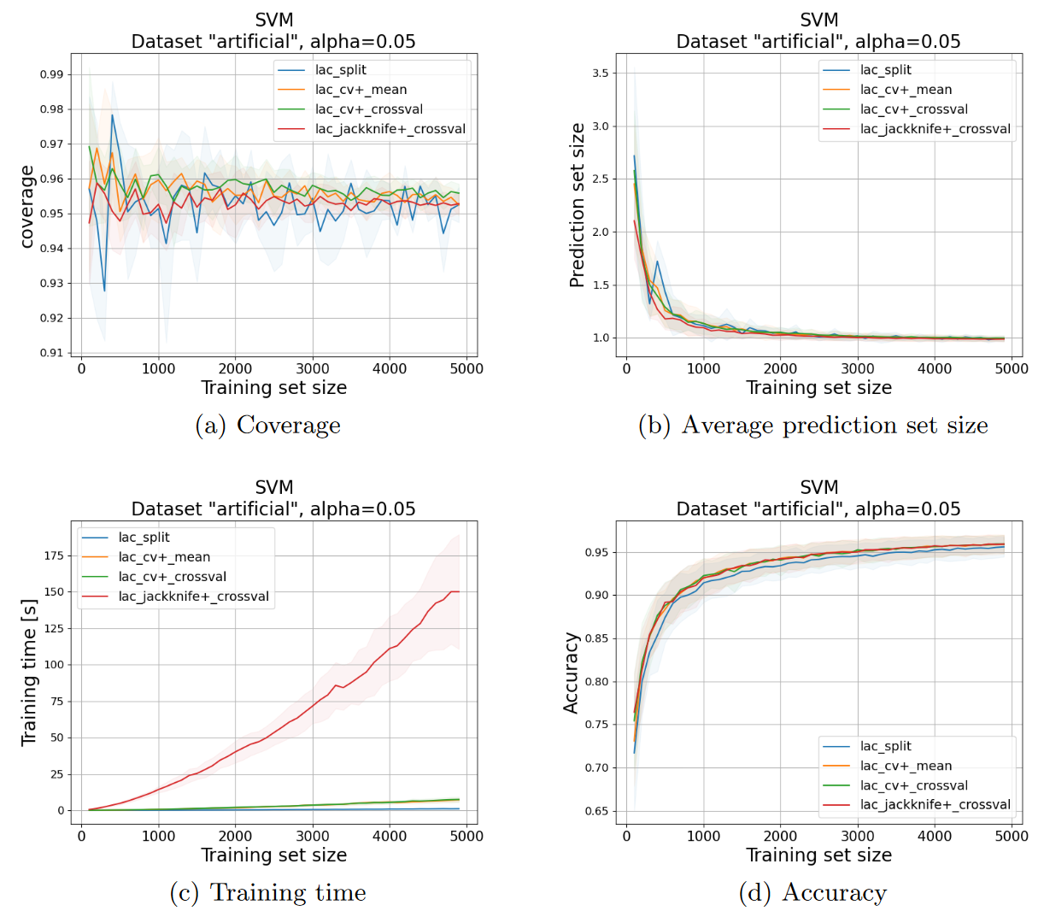
Influence of small datasets on different conformal methods

Slide 27
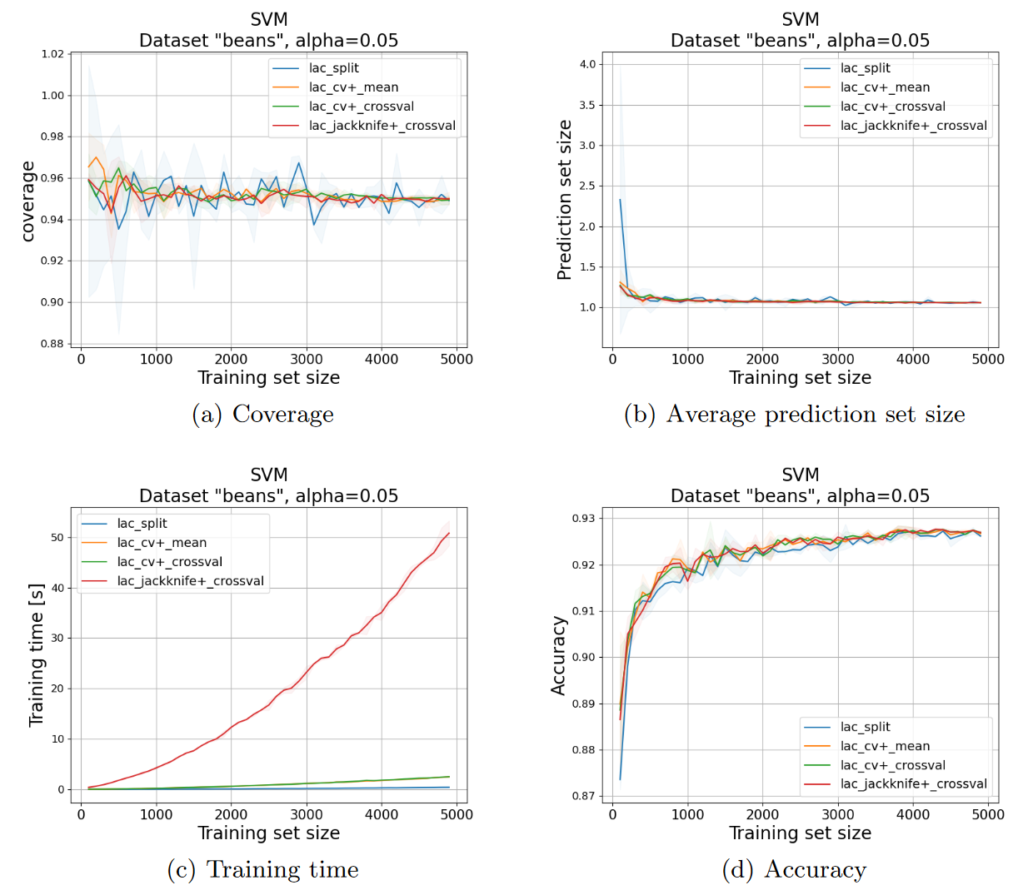
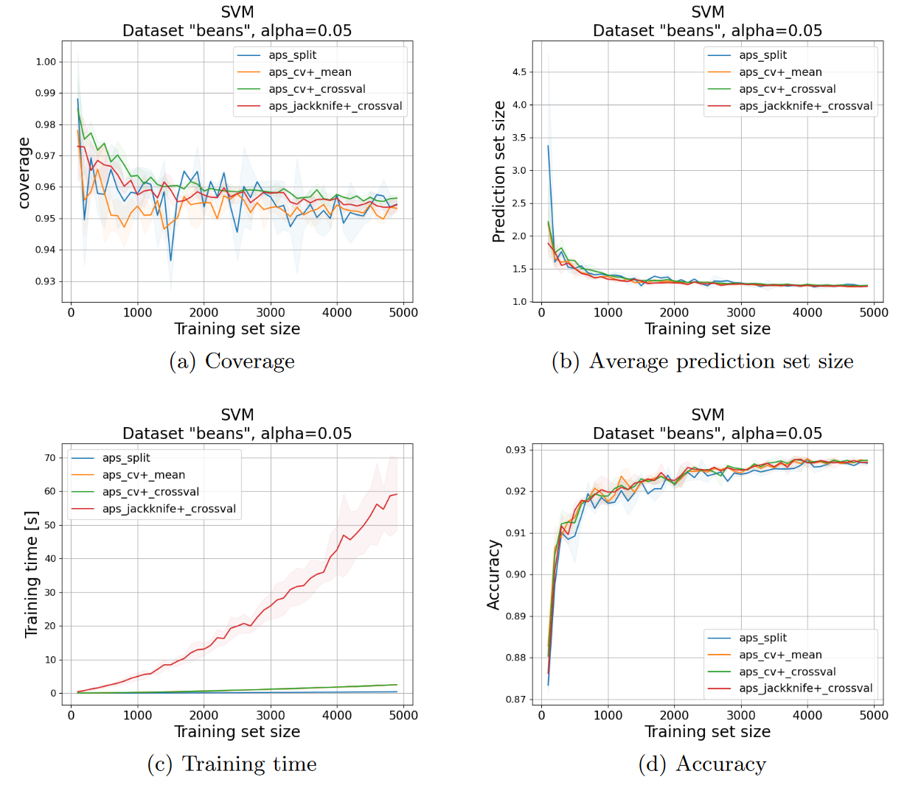
Influence of small datasets on different conformal methods

Slide 28
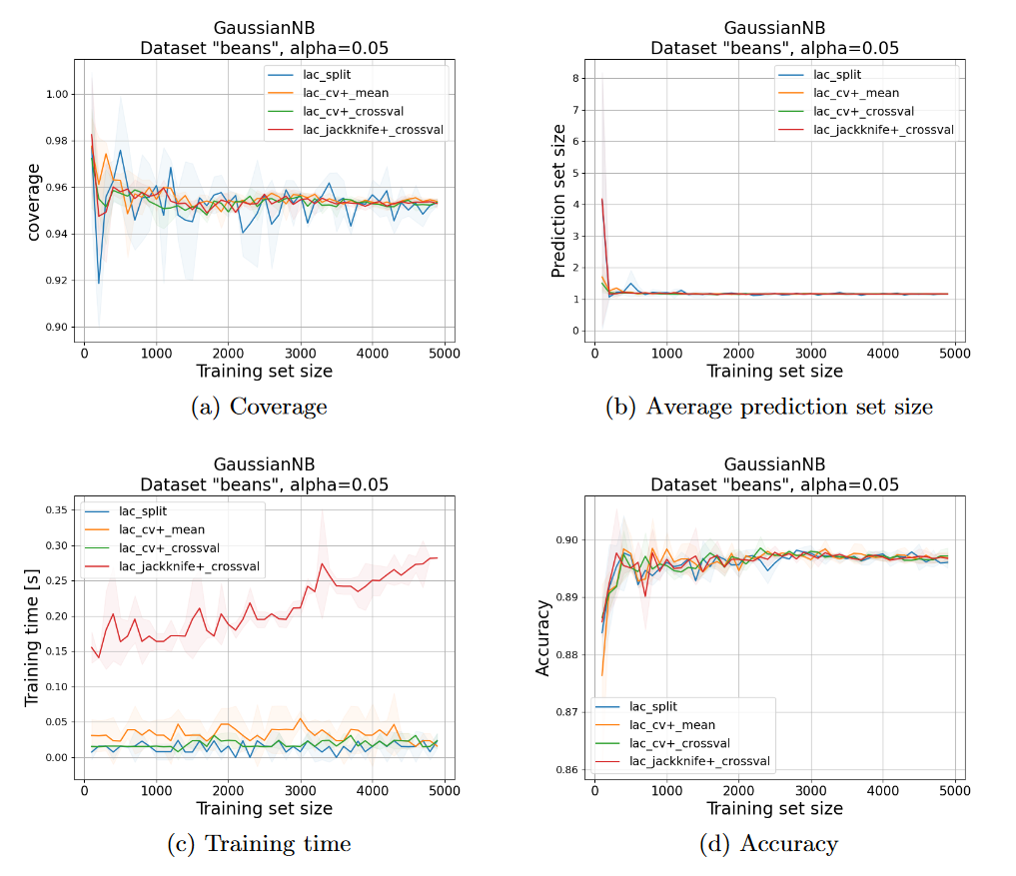
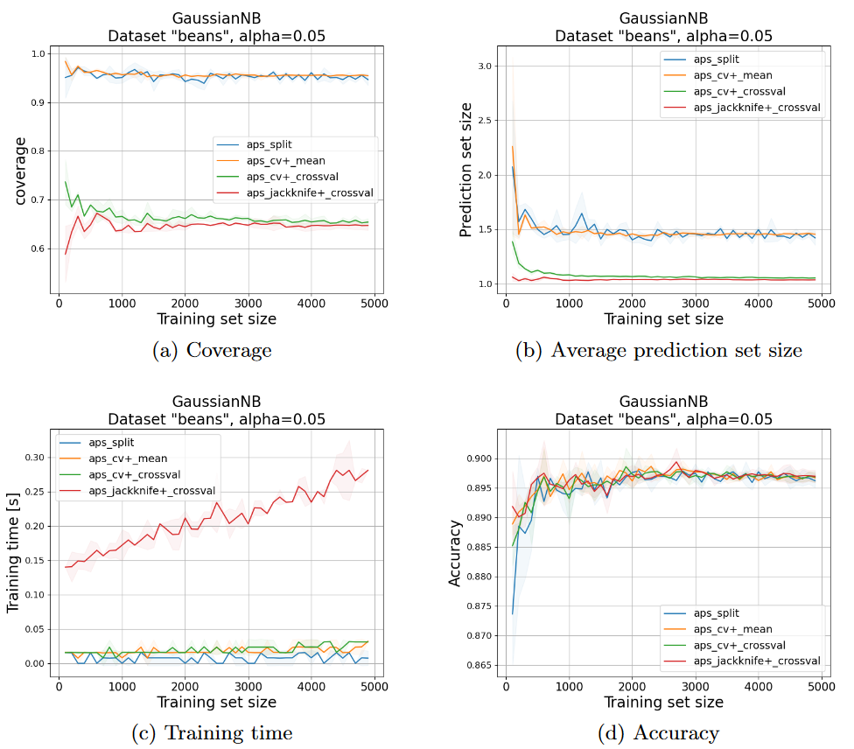
Strange behaviour for aps scores
lac
aps

Slide 29
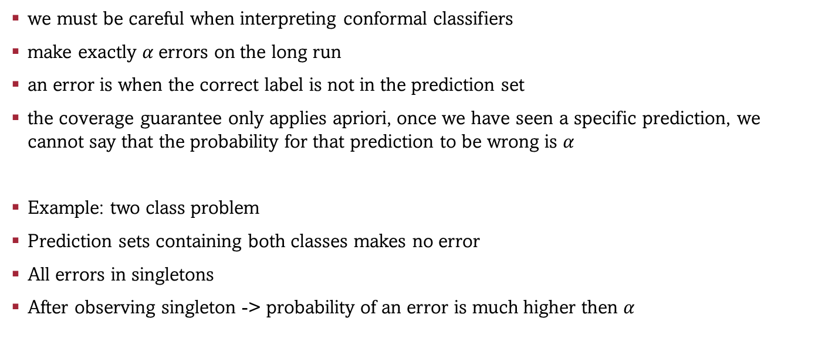
Drawback of Conformal Classifiers
we must be careful when interpreting conformal classifiers
make exactly $α$errors on the long run
an error is when the correct label is not in the prediction set
the coverage guarantee only applies apriori, once we have seen a specific prediction, we cannot say that the probability for that prediction to be wrong is $α$
Example: two class problem
Prediction sets containing both classes makes no error
All errors in singletons
After observing singleton -> probability of an error is much higher then $α$

Slide 30
Where to start ?
“A gentle introduction to conformal prediction and distribution-free uncertainty quantification”
basic overview and foundations
[2] Angelopoulos & Bates
video tutorial: Gentle Introduction – Tutorial
Awesome Conformal Prediction Git Repo
Valery Manokhin
newest stuff
Tonnes of papers, tutorials, videos, theses,
“Conformal prediction: a unified review of theory and new challenges”
[7] Fontana, Matteo, Gianluca Zeni, and Simone Vantini
Contains more the continental approach (after Vovk)
Project: A Glimpse on Conformal Prediction
Michel Lutz
Conformal-prediction-project-repo

Slide 31
END
Appendix:
History of CP
Marginal vs. Conditional Coverage

Slide 32
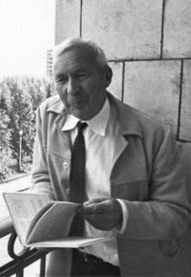


History of Conformal Prediction - I
1960-1980 Andrei Kolmogorov
Moscow State University
randomness, complexity and probability
algorithmically random sequences, finite Bernulli sequences.
Vladimir Vovk becomes his
1988 PhD Thesis Vovk
‘Predictability of algorithmically random’
role of finite-sample exchangeability in prediction problems
1996-1999 Vovk, Gammerman, Vapnik
Royal Holloway University of London
Develop the Conformal Prediction framework

Slide 33



History of Conformal Prediction - III
2014 Sweden
Ulf Johansson, Henrik Boström & Henrik Linusson
Jönköping University
Random forests
Plenty papers & tutorials
Venn predictors
2014 Larry Wassermann
Carnegie Mellon University
“Ambassadors” for CP in the US
Class-balanced CP
Distribution-free predictive inference in regression
2019 Emmanuel Candes
Stanford University
Conformalized Quantile Regression
Plenty papers and fundamental work

Slide 34



History of Conformal Prediction - IV
2020 Adaptive prediction sets
Romano et al. (Candes group)
2020 Washington Post
Used CP method to for the U.S. presidential election
Candes
2021 Michael Jordan
Anastasios N. Angelopoulos and Stephen Bates
UC Berkeley
Large Scale deep learning CP
2021 Conformal Risk Control
Angelopoulos & Bates
2021 Conformal Outlier Detection
Bates

Slide 35



History of Conformal Prediction - V
2021 Change point detection
Vovk
2021 Trak at ICML2021&2022
Emmanuel Candes
2022 NeurIPS2022
Emmanuel Candes
2021 Awesome Conformal Prediction
Git Repo
Valery Manokhin (PhD Student Vovk)
2022 MAPIE
Scikit-learn compatible package
2022 CP Beyond Exchangeability
Candes, Ryan Tibshirani

Slide 36
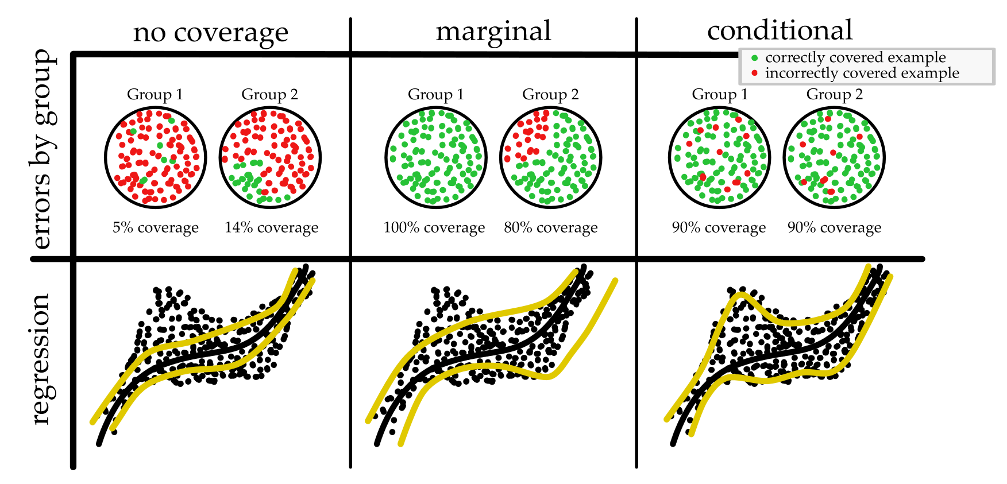
Marginal vs. conditional coverage
Figure taken from: [2] Angelopoulos, A. N., & Bates

Slide 37
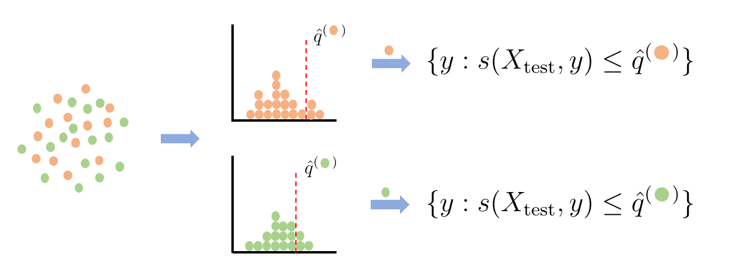
Group-balanced conditional coverage

Slide 38
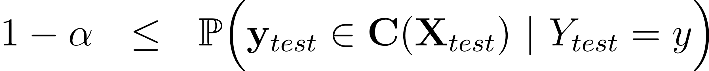
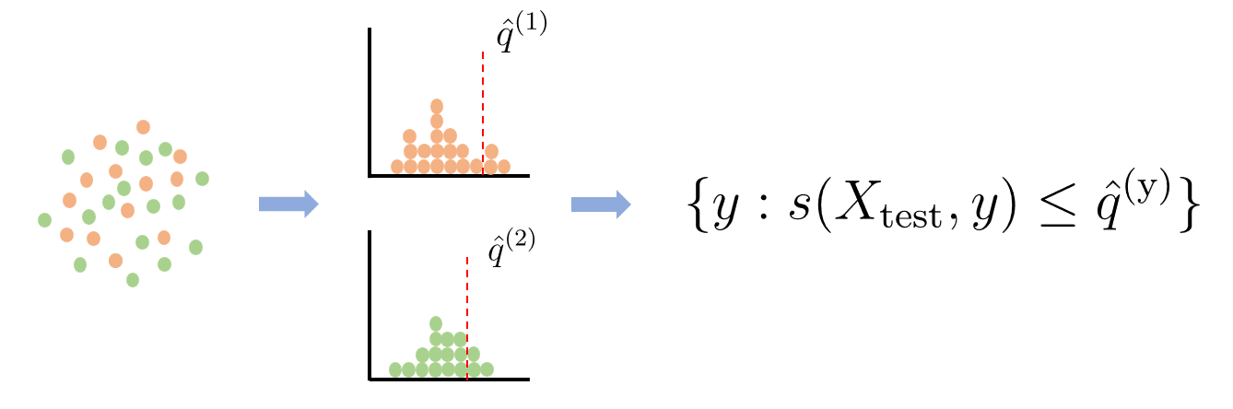
Class-balanced conditional coverage

Slide 39
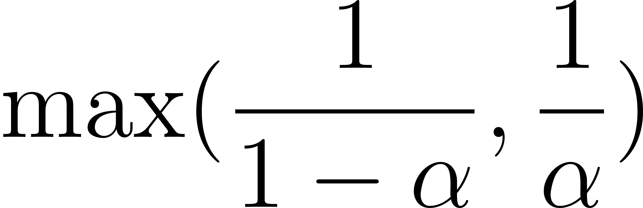

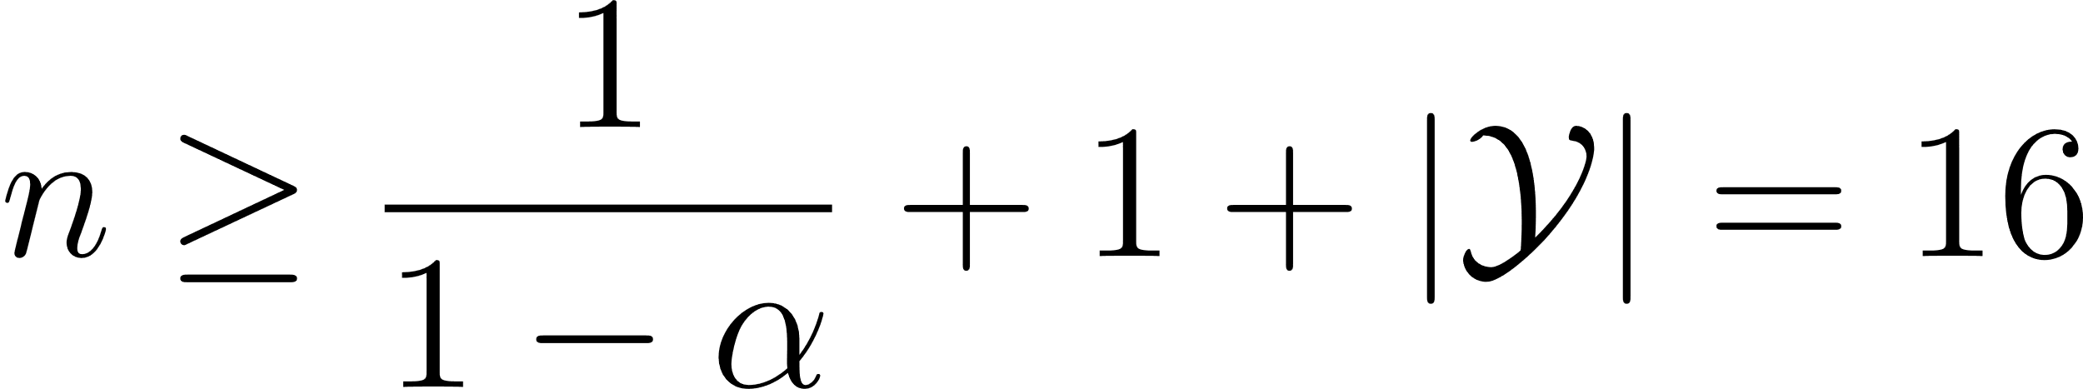
Additional Experiments – very small datasets
smallest possible calibration-set size for conformal methods
necessary for determine the 1-alpha quantile
smallest training set size
for 5 classes and alpha=0.1

Slide 40
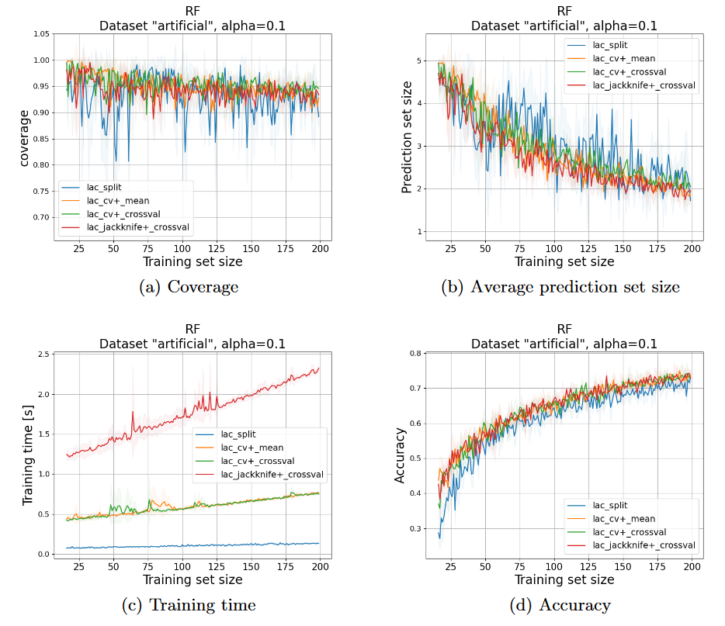
Additional Experiments – very small datasets

Slide 41
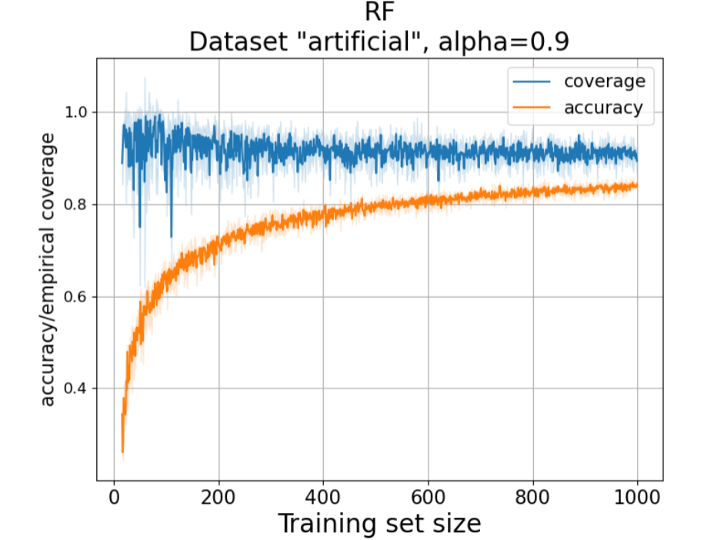
Additional Experiments – direct comparison acc and cov
Notes:
Direct comparison accuracy and coverage.

Slide 42
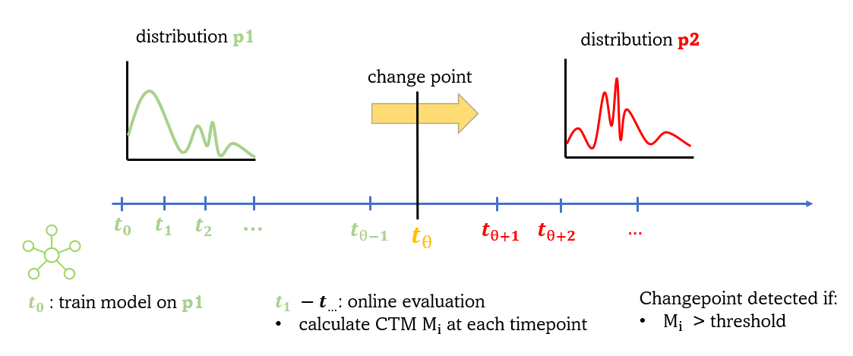
Conformal Change Point Detection
Based on Vovks Paper:
Retrain or not retrain: conformal test martingales for change-point detection [8] (2021)
Scenario:

Slide 43
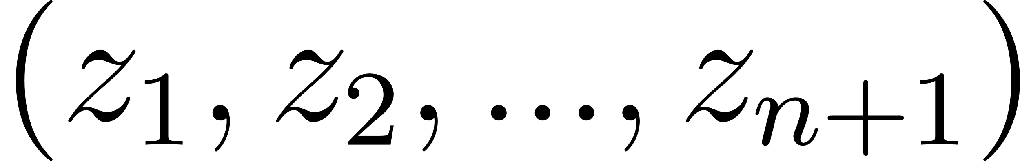


Conformal Test Martingales CTM
data sequence:
conformity measure:
p-values:
CTM:
F is a betting martingale function

Slide 44


Betting Martingale
for all sequences:
therefore, the following property holds:

Slide 45


CTM: betting martingale function – Simple Jumper
with

Slide 46

CTM: Vovks results
Red wine
White wine
Change point

Slide 47

CTM - properties
under iid. p-values are uniformly distributed in [0,1]
Simple Jumper martingales fulfil Ville’s inequality:
$M_{i}$ are equal under iid.
CTM are equal under iid.
$M_{i}$ > c with false alarm rate of alpha = 1/c if iid. violated

Slide 48

CTM: Vovks results
CTM controls the false alarm rate
controlling c
not as efficient as other methods (CUMSUM, Shiryaev-Roberts procedure)
Empirically detect change point for clear changepoint and clear to separate distributions after 20-30 datapoints
best conformity measure function:
Even better then L1-Norm
Possible because real label is available in online setting

Slide 49
PERMAD Dataset
41 oncological patients
total 647 measurements
different number of measurements per patient (min: 4, max: 46)
time distributed irregularly and different for each patient
91 Features
CT scans at irregular intervals
progression / non-progression
Task: predict the change-point, from non-progression to progression

Slide 50
PERMAD Dataset - Idea
No ground truth
Learn an unsupervised representation of “non-progression” and “progression”
What is p1 , what p2
Solution: fist datapoint of each patient is “non-progression” , last progression
Model: Autoencoder
Training: Two AE one in the first one on the last datapoints of all patients
Non-conformity measure
difference between t_0 and t_i (reconstructions / embeddings)
use both AEs alone and in combination
diff, L1, L2, cross-entropy
Calculate CTM as search for a method that shows a changepoint

Slide 51






PERMAD Dataset – Results (L1 – embeddings)

Slide 52






PERMAD Dataset – Results (L2 – embeddings)

Slide 53

PERMAD Dataset - Results
Detect change point with 10% false alarm rate:
$M_{i}$ > 10

Slide 54
PERMAD Dataset - Problems
CTM and the given task does not match
No ground truth / no supervised task
CTM is not efficient (requires in bast case scenarios >20 datapoints of the other distribution)
Questionable if “non-progression” / “progression” distribution exists ?
Are intersubject differences bigger then “progression”/ “non-progression”?
Maybe more than one change point?
available features reflect more than just the oncological status
Subject: can become sick, co-medication, …
smooth transition, not an abrupt change

Slide 55
Quellen
[1] Vovk, V. (2012). Conditional validity of inductive conformal predictors. In Asian conference on machine learning, Vol. -, pp. 475–490. PMLR.
[2] Angelopoulos, A. N., & Bates, S. (2021). A gentle introduction to conformal prediction and distribution-free uncertainty quantification. arXiv preprint arXiv:2107.07511
[3] Romano, Y., Sesia, M., & Candes, E. (2020). Classification with valid and adaptive coverage. Advances in Neural Information Processing Systems, 33, 3581–3591
[4] Lei, J., & Wasserman, L. (2014). Distribution-free prediction bands for non-parametric regression. Journal of the Royal Statistical Society Series B: Statistical Methodology, 76 (1), 71–96.
[5] Lei, J. (2014). Classification with confidence. Biometrika, 101 (4), 755–769
[6] Koklu, M., & Ozkan, I. A. (2020). Multiclass classification of dry beans using computer vision and machine learning techniques. Computers and Electronics in Agriculture, 174, 105507.
[7] Fontana, Matteo, Gianluca Zeni, and Simone Vantini. "Conformal prediction: a unified review of theory and new challenges." Bernoulli 29.1 (2023): 1-23.
[8] Vovk, V., Petej, I., Nouretdinov, I., Ahlberg, E., Carlsson, L., & Gammerman, A. (2021). Retrain or not retrain: Conformal test martingales for change-point detection. In Conformal and Probabilistic Prediction and Applications, pp. 191–210. PMLR.

